Slide 1
Employment Report
First half of 2020
Labour market key indicators
Lisbon, October 2020

Slide 2

Macroeconomic framework
Production, demand and prices
GDP AND MAIN COMPONENTS OF EXPENDITURE – ANNUAL PERCENTAGE RATE OF CHANGE (EXPENDITURE APPROACH, RATE OF CHANGE IN VOLUME)
 | 2020 |  | 2019 |  |  |  | 2019 | 2018
 | Q2 | Q1 | Q4 | Q3 | Q2 | Q1
GDP (EU)* (a) | -14,0 | -2,5 | 1,1 | 2,1 | 1,3 | 1,7 | 2,8 | 2,1
GDP pps (PT) (b) | -16,3 | -2,3 | 2,2 | 1,9 | 2,1 | 2,4 | 2,2 | 2,6
Domestic demand | -12,0 | -1,2 | 1,1 | 3,4 | 3,1 | 3,7 | 2.8 | 3.1
Final consumption expenditure of resident households | -12,3 | -0,7 | 1,9 | 2,3 | 1,7 | 2,1 | 2.0 | 2.5
General government final consumption expenditure | -10,8 | -3,5 | -2,0 | 8,2 | 9,6 | 11,4 | 6.6 | 6.2
Gross capital formation | -39,5 | -5,1 | 6,2 | 2,2 | 2,6 | 3,9 | 3.7 | 4.5
Gross fixed capital formation | -29,9 | -2,5 | 3,6 | 5,7 | 4,9 | 7,1 | 5.3 | 5.7
Exports of goods (FOB) and services | -16,3 | -2,3 | 2,2 | 1,9 | 2,1 | 2,4 | 2,2 | 2,6
Imports of goods (FOB) and services | -12,0 | -1,2 | 1,1 | 3,4 | 3,1 | 3,7 | 2.8 | 3.1
External balance of goods and services as a % of GDP | -12,3 | -0,7 | 1,9 | 2,3 | 1,7 | 2,1 | 2.0 | 2.5
* At the present date, this information refers only EU 27.
Source: Table (a) EUROSTAT (Table [nama_10_gdp] and [namq_10_gdp]; (b) INE, National accounts (reference year: 2016).

Slide 3
Macroeconomic framework
Production, demand and prices
Harmonised Index of Consumer Prices – Annual rate of change (Monthly data)
Source: EUROSTAT, table [prc_hicp_manr].

Slide 4
Macroeconomic framework
Production, demand and prices
Harmonised Index of Consumer Prices – Annual rate of change (Monthly data)
Source : EUROSTAT, table [prc_hicp_manr].

Slide 5
Macroeconomic framework
Production, demand and prices
Harmonised Index of Consumer Prices – Annual rate of change (Monthly data)
Source : EUROSTAT, table [prc_hicp_manr].

Slide 6
LABOUR MARKET
Activity, employment and unemployment
Active, inactive and employed population
Source : INE, Labour force survey

Slide 7
LABOUR MARKET
Activity, employment and unemployment
Activity rate (as % of the population aged 15 to 64)
Source : INE, Labour force survey

Slide 8
LABOUR MARKET
Activity, employment and unemployment
Employment rate ( as % of the population aged 15 to 64)
Source : INE, Labour force survey

Slide 9
LABOUR MARKET
Activity, employment and unemployment
EMPLOYEES BY TYPE OF CONTRACT
Note: * Other contracts include seasonal, occasional and service contracts.
Source : INE, Labour force survey

Slide 10
LABOUR MARKET
Activity, employment and unemployment
POPULATION EMPLOYED BY SECTORS OF ACTIVITY
A | Agriculture, forestry and fishing | M | Professional, scientific and technical activities
C | Manufacturing | N | Administrative and support service activities
F | Construction | O | Public administration and defence; compulsory social security
G | Wholesale and retail trade; repair of motor vehicles and motorcycles | P | Education
H | Transportation and storage | Q | Human health and social work activities
I | Accommodation and food service activities | R | Arts, entertainment and recreation
J | Information and communication | S | Other service activities
K | Financial and insurance activities | T | Activities of Households as Employers; Undifferentiate Goods and Services Producing Activities of Households for Own Use
L | Real estate activities
Source : INE, Labour force survey

Slide 11
LABOUR MARKET
Activity, employment and unemployment
Unemployment rate (as % of the population aged 15 and over)
Source : INE, Labour force survey

Slide 12
LABOUR MARKET
Activity, employment and unemployment
Unemployment rate by region
Source : INE, Labour force survey

Slide 13
LABOUR MARKET
Activity, employment and unemployment
UNEMPLOYED POPULATION BY DURATION OF JOB SEARCH
Source : INE, Labour force survey

Slide 14
LABOUR MARKET
Activity, employment and unemployment
REGISTERED UNEMPLOYMENT
Source: IEFP, Labour Market

Slide 15
LABOUR MARKET
Activity, employment and unemployment
REGISTERED UNEMPLOYMENT - Movement over the months of
the first half of 2020
Thousands
Source: IEFP, Labour Market

Slide 16
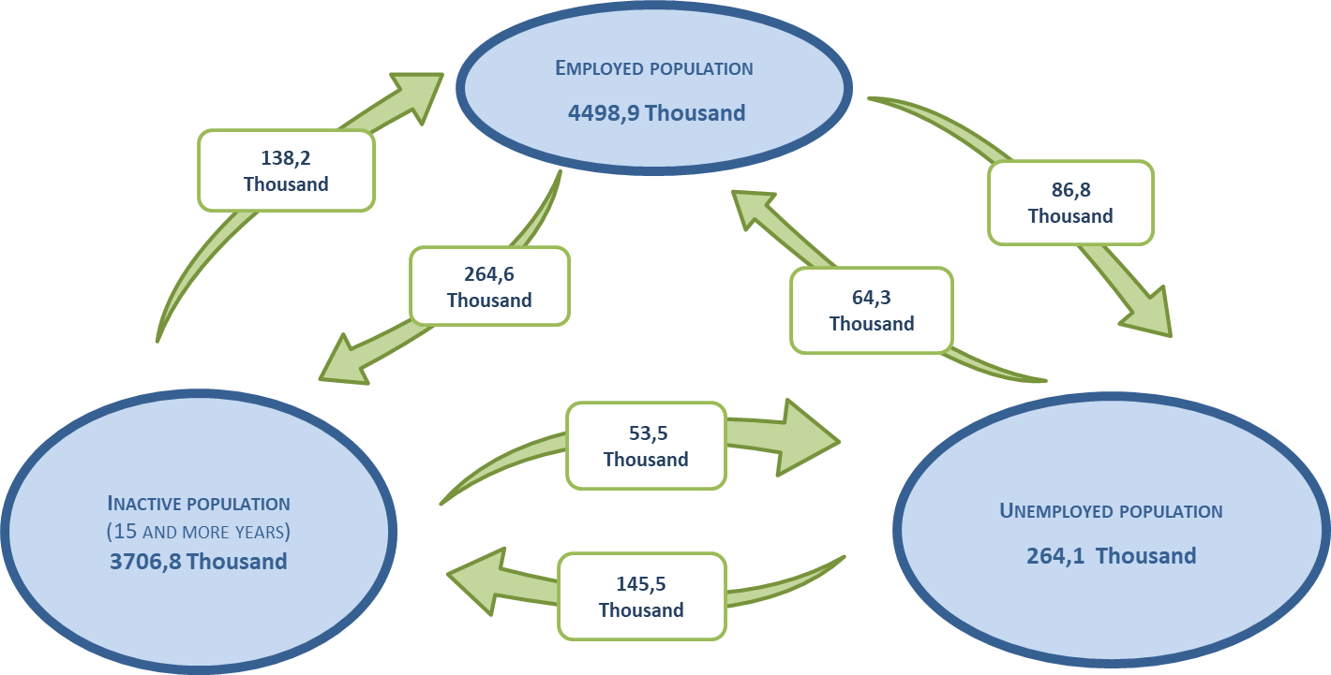
LABOUR MARKET
Activity, employment and unemployment
ENTRY AND EXIT FLOWS BETWEEN INACTIVITY, EMPLOYMENT AND UNEMPLOYMENT
2nd Quarter of 2020
Source: INE, Labour Force Survey

Slide 17
Exceptional support measures in the context of a pandemic (covid-19)
NUMBER OF EMPLOYEES COVERED BY EMPLOYERS WHO APPLIED FOR THE SIMPLIFIED LAY-OFF
Thousands
Source: II/MTSSS, Social Security Statistics (www.gep.mtsss.gov.pt)

Slide 18
Exceptional support measures in the context of a pandemic (covid-19)
EMPLOYERS WHO APPLIED FOR THE SIMPLIFIED LAY-OFF
Thousands
Source: II/MTSSS, Social Security Statistics (www.gep.mtsss.gov.pt)

Slide 19
Exceptional support measures in the context of a pandemic (covid-19)
NUMBER OF WORKERS COVERED BY THE SIMPLIFIED LAY-OFF BY ECONOMIC ACTIVITY
Thousands
Source: II/MTSSS, Social Security Statistics (www.gep.mtsss.gov.pt)

Slide 20
Exceptional support measures in the context of a pandemic (covid-19)
EMPLOYERS WHO APPLIED FOR THE SIMPLIFIED LAY-OFF BY REGION
Source: II/MTSSS, Social Security Statistics (www.gep.mtsss.gov.pt)

Slide 21
Exceptional support measures in the context of a pandemic (covid-19)
EMPLOYERS WHO APPLIED FOR THE SIMPLIFIED LAY-OFF BY SIZE OF ENTERPRISE
Source: II/MTSSS, Social Security Statistics (www.gep.mtsss.gov.pt)

Slide 22
Gains and earnings
EVOLUTION OF THE AVERAGE MONTHLY EARNINGS OF FULL-TIME EMPLOYEES
€
Source : GEP, Earnings and working time survey

Slide 23
Gains and earnings
EVOLUTION OF THE AVERAGE MONTHLY BASIC REMUNERATION PLUS REGULAR INSTALMENTS OF FULL-TIME EMPLOYEES
€
Source : GEP, Earnings and working time survey

Slide 24
Gains and earnings
AVERAGE MONTHLY EARNINGS OF FULL-TIME EMPLOYEES BY REGION – APRIL 2019
€
Source : GEP, Earnings and working time survey

Slide 25
Gains and earnings
AVERAGE MONTHLY EARNINGS OF FULL-TIME EMPLOYEES BY SEX – APRIL 2019
€
Source : GEP, Earnings and working time survey

Slide 26
LABOUR MARKET
Job offers
JOB OFFERS BY REGION (Situation at the end of the month)
Fonte: IEFP, Labour Market

Slide 27
CENTRE FOR LABOUR RELATIONS
More information at
www.crlaborais.pt

